Slide 1
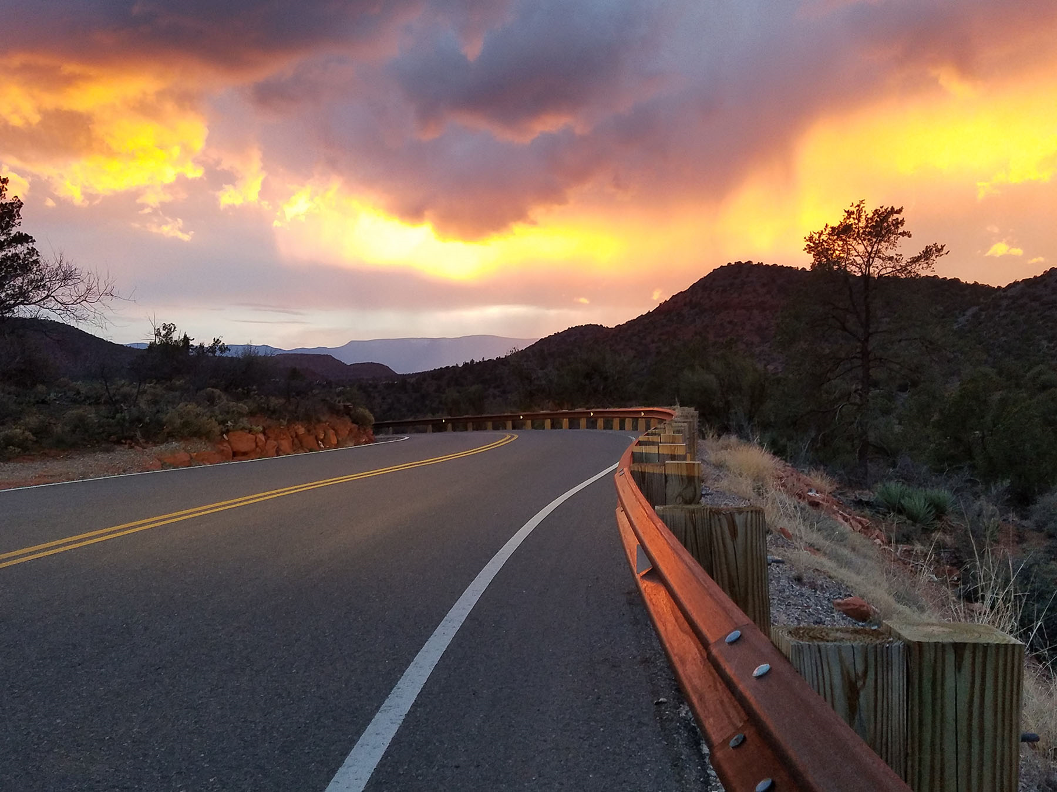
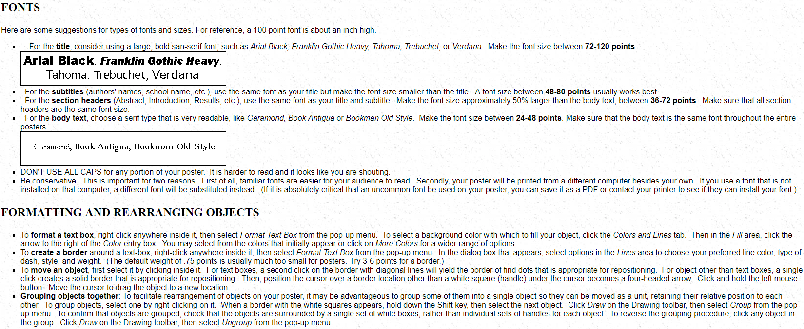
Keep all images and text inside of the margins.
The smallest images should have 600 x 400 pixels, like this.
If the image needs to be larger, use an image with higher pixels to avoid distortion when printing.
The background image should be 1800 x 1350, anything smaller that is enlarged will distort when printed.
More Information like this can be found here:
http://abacus.bates.edu/~bpfohl/posters/
REMEMBER TO:
-Spell Check your document
-Save the ‘Working Slide’ as a PDF to send along for printing

